Slide 1
WRF-SUEWS Online Cooping Test
Ning ZHANG
2018-04-23

Slide 2
Model version and basic design
WRF-ARW-3.61
SUEWS2013b
Coupled SUEWS into NOAH LSM as a parameterization scheme for urban surface processes

Slide 3
Workflow
WRF-Dynamical Core
Land surface model interface
NOAH LSM
SUEWS
Result files
Local land surface parameters

Slide 4
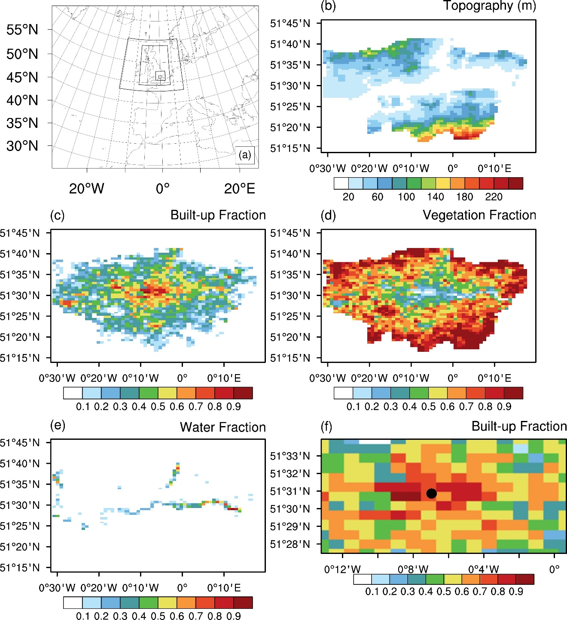
Simulation (a) domain configuration and input data (b) topography (SOURCE), (c) building (check or building+ paved ) fraction (SOURCE), (d) vegetation cover fraction, (e) water body fraction of the analysis area in domain 5 and (f) the observation site of KSS at King’s College of London .

Slide 5
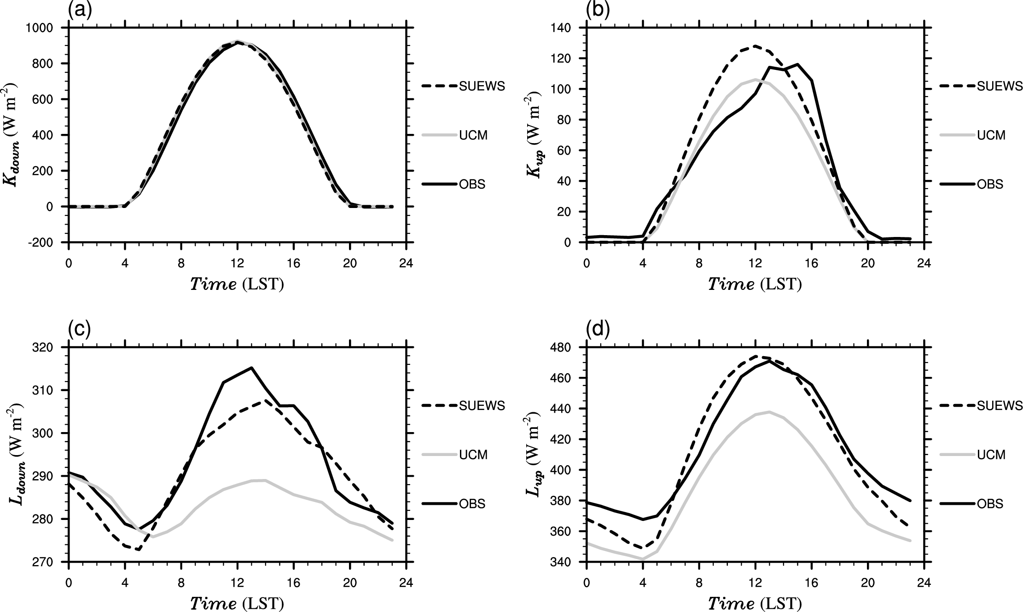
Figure 2. Comparisons of surface radiation balance: (a) downward short-wave radiation; (b) upward short-wave radiation; (c) downward long-wave radiation; (d) upward long-wave radiation.

Slide 6
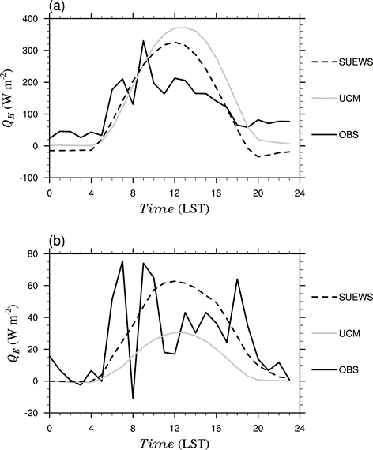
Comparisons of simulated surface turbulence fluxes with observations at the KSS site (51.51E, 0.116W, 40m above the ground), King’s College of London: (a) sensible heat flux; (b) latent heat flux.

Slide 7
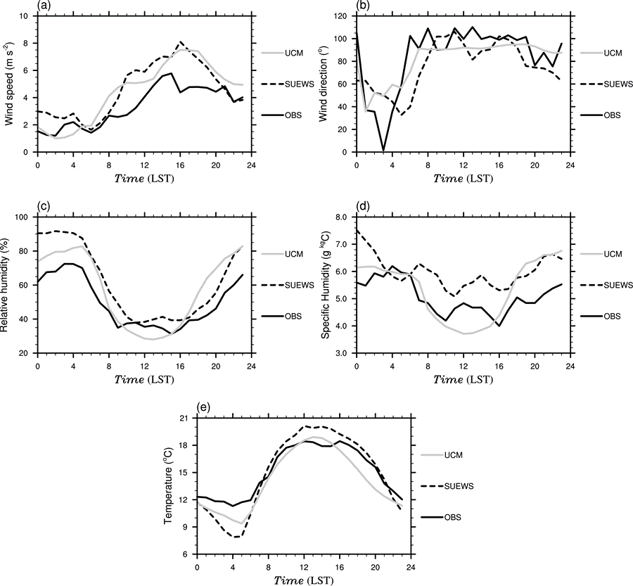
Fig 4. Comparisons of simulated surface meteorological fields with the observations at the KSS site: (a) wind speed; (b) wind direction; (c) relative humidity; (d) specific humidity and (e) temperature.

Slide 8
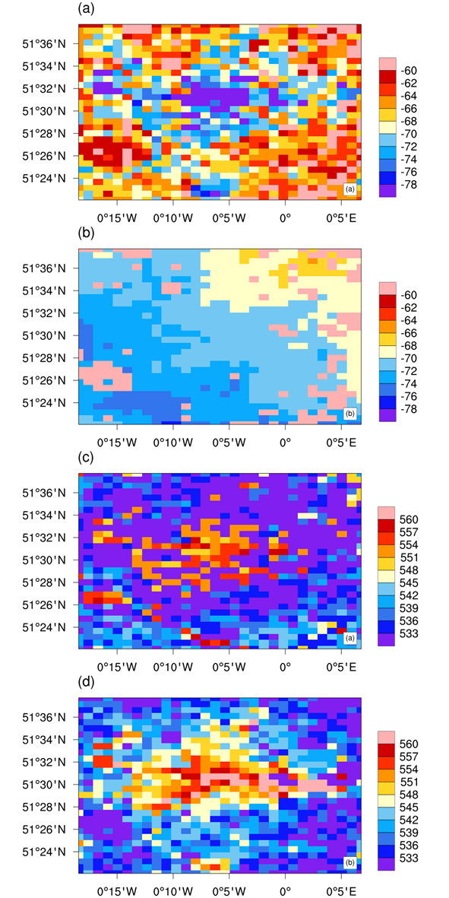
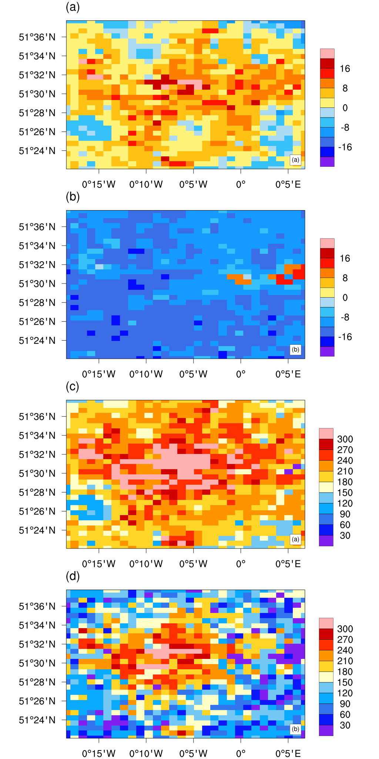
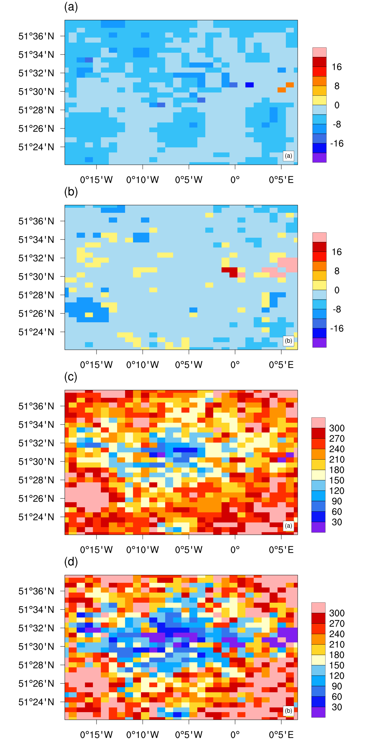
Rn SH LH
WRF-SUEWS
WRF-UCM
WRF-SUEWS
WRF-UCM
02：00
02：00
14：00
14：00

